Slide 1
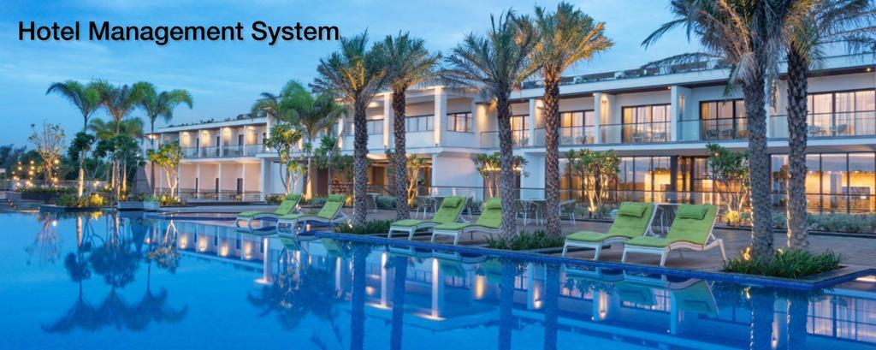

Slide 2
Project Description

Slide 3
Project Description
Hotel Management System is a web-based application that allows the hotel manager to handle all hotel activities online. Interactive GUI and the ability to manage various hotel bookings and rooms make this system very flexible and convenient.
This application gives him the power and flexibility to manage the entire system from a single online system. Hotel management project provides room booking, staff management and other necessary hotel management features.
The system allows the manager to post available rooms in the system. Customers can view and book room online. Admin has the power of either approving or disapproving the customer’s booking request.
Other hotel services – spa, restaurant reservations, gyms - can also be viewed by the customers and they can book them too. The system is hence useful for both customers and managers to manage the hotel activities.

Slide 4
Business Case
We consider a Hotel ABC for our project. The Hotel Management system provides hotel and resort owners with sustainable and durable management and marketing solutions.
Clients and users will be supported by a well-organized and sophisticated infrastructure and an experienced management team that understands the magnitude of the problems, deal with them and finds efficient ways for optimising revenue across the business spectrum - from increasing room sales, upgrading finance and business revenue, maximizing meeting and conference opportunities and enhancing the unique image and positioning of the property.
The aim is to provide a satisfactory and pleasant stay to the customers and encourage them to visit the hotel again.

Slide 5
Business Problems
Login issues : While logging into the system for the customer as well as the working staff, error might occur due to poor connectivity or server issues.
Miscommunication during booking : Due to poor communication between the departments, guests are served with services they didn’t order.
Negative feedback : Due to poor management of the system, several cases were reported where guests complained of overcharging for services not used by them
Human and computational errors : Many errors enabled by the system due to tedious
Computations required during data processing cost the hotel management heavily.

Slide 6
Project Methodology
and
Stakeholder Description template

Slide 7
Executive Summary
In this document, we identify the methodology which we will follow for our semester project. After an analysis of the types of methodologies, we have chosen the WaterFall Methodology. After that, we assign roles to all our team members and also identify the stakeholders i.e the persons/groups who have some interest or level of influence which can impact this project.

Slide 8
Selection of Methodology
This is a small-size project where our requirements are easily understood, therefore we will be following the Waterfall methodology for our project design and management. Using this methodology, we will define all of our phases required to complete the project at the initial stage.Waterfall methodology is a sequential and structured design process. This model shows a project mindset and places its focus completely on accomplishing the project, which is exactly what we need for our semester project.

Slide 9
Roles and Methods
Project Manager:
A project manager plays the lead role in planning, executing and monitoring the project. He/She assigns the roles to the team members.
Business Analyst:
A business analysts job is to ensure that the end product meets the needs of the key stakeholder’s and they also look for ideas to promote the product.
Tester :
A tester will find the bugs in the final software and ensure that it is market ready.
Developers :
Developers will be the people writing the code.

Slide 10
Identification of Stakeholders
Designation | Role in Project
Project Manager and Developer | Plays the lead role in planning, executing, monitoring, controlling and closing projects.
Business Analyst and Developer | Business Analyst
Tester and Developer | Tester
Sponsor | Project could link cars in particular city where the hotel is situated and that’ll increase revenue
Sponsor and Reviewer | Will provide the fundings and information regarding the Hotel

Slide 11
Interest and Influence of the Stakeholders
Role in Project | Interest | Influence | Priority
Project Manager,Developer | High | High | 1
Business Analyst, Developer | High | High | 1
Business Analyst, Developer | High | High | 1
Tester, Developer | High | High | 1
Will provide the fundings and information regarding the Hotel | High | Medium | 2
Project could link cars in particular city where the hotel is situated and that’ll increase revenue | Low | Low | 3

Slide 12
Functional Requirements
The software proceeds to record the reservations
The software shall record the customer’s personal details.
The software shall record the expected check-in date and time.
Display whether or not the room is guaranteed.
The software shall allow reservations to be modified without having to reenter all the customer details.
The software shall record customer feedback.
Food
The software shall track all meals purchased in the hotel.
The software shall accept reservations for the restaurant an room service
8) Management
Display hotel occupancy for a specified period of time.
Display food revenue
Allow for the modification of information regarding rooms and other services.

Slide 13
Non Functional Requirements:
The software shall support a large number of users without any fault at any given moment.
Responses to view shall take no longer than 5 seconds to appear on screen.
The software shall have appropriate security measures.
Availability
he software shall be available 24 hours a day, 365 days a year.
The software shall store all the details of the customers.
The software shall login the employee or admin within 5 seconds.
5) Error Handling
The software shall report internal errors, bugs, glitches etc
The software shall have a separate tab for help & support regarding any errors related to the employee database.

Slide 14
System Requirement
Software Requirements:
1.HTML, CSS
Hardware Requirements:
1.Processor: Pentium 2 266MHz or higher
2.RAM: 128MB or more
3.Hard Disk: 128MB or more

Slide 15
Project Plan

Slide 16
Work Breakdown
Module | Activity | Sub-Task | Assigned to
E1 | Design dashboard | Prepare a digital design for dashboard | Rishabh
 |  | Convert design to static web page in html, css | Rishabh
E2 | Design registration page | Prepare question for registration | Ankur
 |  | Convert questions to another page for website | Pavan
E3 | Design Questionnaire for tourist preference | Research appropriat e questions | Ritesh
 |  | Add questions to page in website | Ritesh
E4 | Identify APIs providing best description for Hotel Rooms and Facilities | Research APIs for rooms and facilities description s | Ankur
 |  | Integrate and add to final website | Pavan
E5 | Documentati on | Completing detailed documentati on for entire project | Rishabh, Ritesh, Ankur and Pavan

Slide 17
Cost and Effort Estimation
Activity | Description | Effort (in hours/perday) | Cost (in INR/permonth)
Research and development | Providing insights into the marketEvaluating the software technology trends and incorporating them with updates andpatches | 8 hours | For Research - 60K For Rolling out patches/updates – 40K
Application Development | To create desktop level application using Python 3, HTML/CSSand SQL. | 6 – 8 hours | Full Stack-65K Frontend-35K Backend-55K
Data Analytics | Administrator of Data, Employee Database Management, Evaluating the trendsin data | 10 hours (with shifts) | Data Analyst-90K Data Scientist-80K
Licensing/ Trademarks/ Copyrighting | DatabaseServerTerms and conditionsTrademarkingCopyrighting | As per requirement | 1L (only once)
Sales and Marketing | Advertisements,Public Relations, Launch events | As per requirement | 1L
Customer Care | Customer support andqueries | 24 hours (withshifts) | 10K-15K

Slide 18
Work Division
Name | Role | Responsibilities
Rishabh Mishra | Project Lead | Design end-to-end architecture, provide training and support, team management, monitoringand controlling
Ankur Choudhary | Business Analyst and UX Designer | Discuss and Document Requirements.Design the user experience.
Ritesh Chandwani | Frontend Developer and Tester | Develop user interface Perform testing for varioustest cases, identifying bugs and glitches
Pavan Kiran | Backend Developer | Coding and Debugging, UI testing to optimize performance, maintainingdatabase

Slide 19
Risk Identification
Deficiency of sufficient human resources due to unavailability which leads to slowing down of development of software.
Techanical difficulties such as Data Security and Improper management of data can threaten the quality of software to be produced.
Since with the short amount of time, and less maintenance it could lead high amount of bugs and glitches in the Software.
Low stakeholder engagement-The stakeholder might not interact with the team at frequency required to maintain high productivity levels.

Slide 20
Risk Management
More allocation of fund towards human resource for the creation of software.
Prior emphasis on correct measures to be taken for data management and security. Also hiring of experienced staff (admin) for the same to avoid any hinderance in the future.
Implementing User Acceptance Criteria to have stakeholders affirm the project is up to standard, regular coding reviews, usage of Clear coding standards and guides, and extensive testing of the software, and regular updating and maintenance of program.
Clear agreements with the employee or admins around response times.

Slide 21
Architecture Diagrams

Slide 22
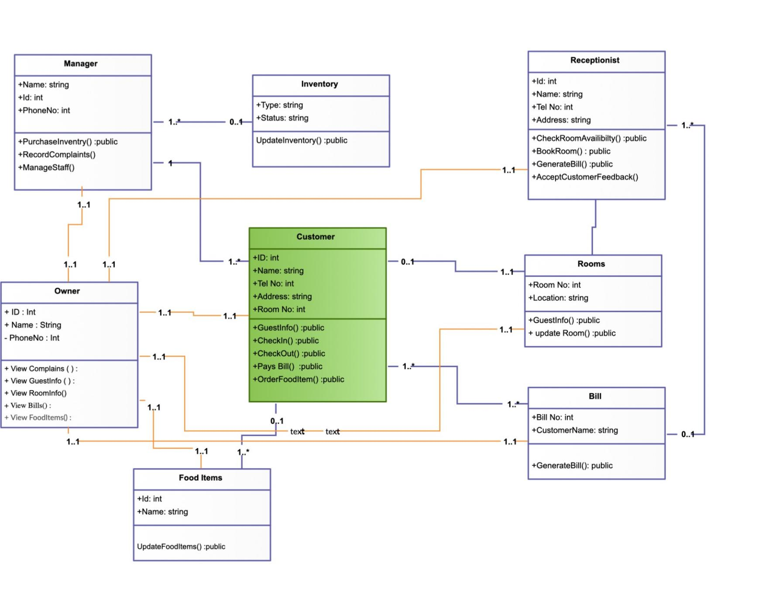
Class Diagram

Slide 23
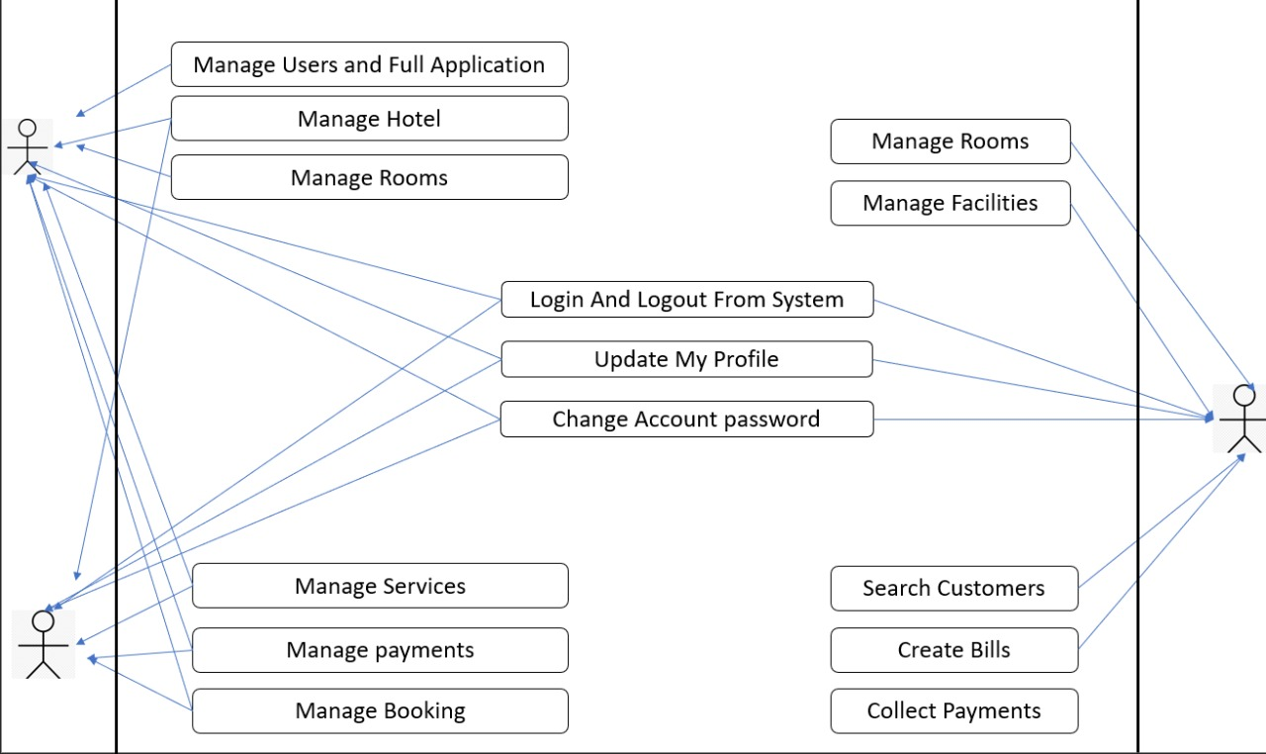
Use Case Diagram

Slide 24
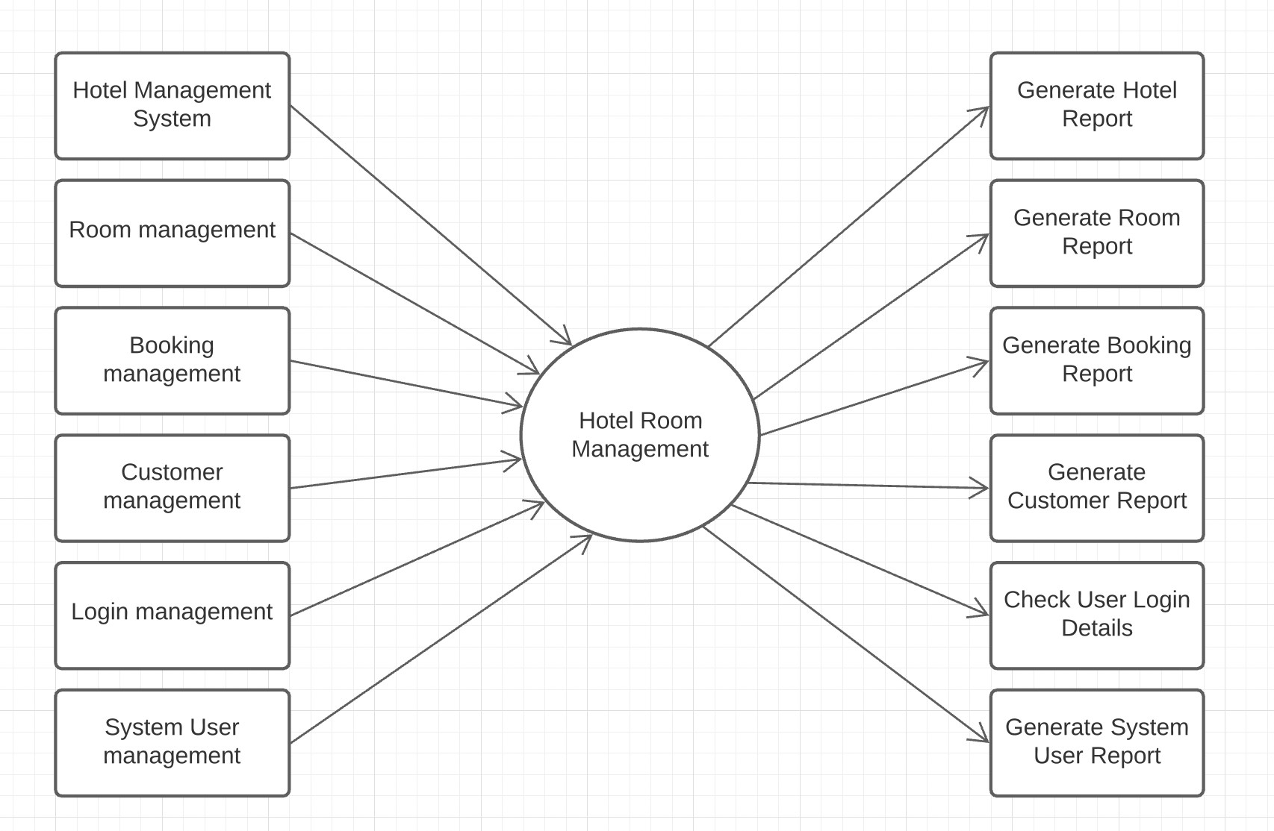
DFD Diagram

Slide 25
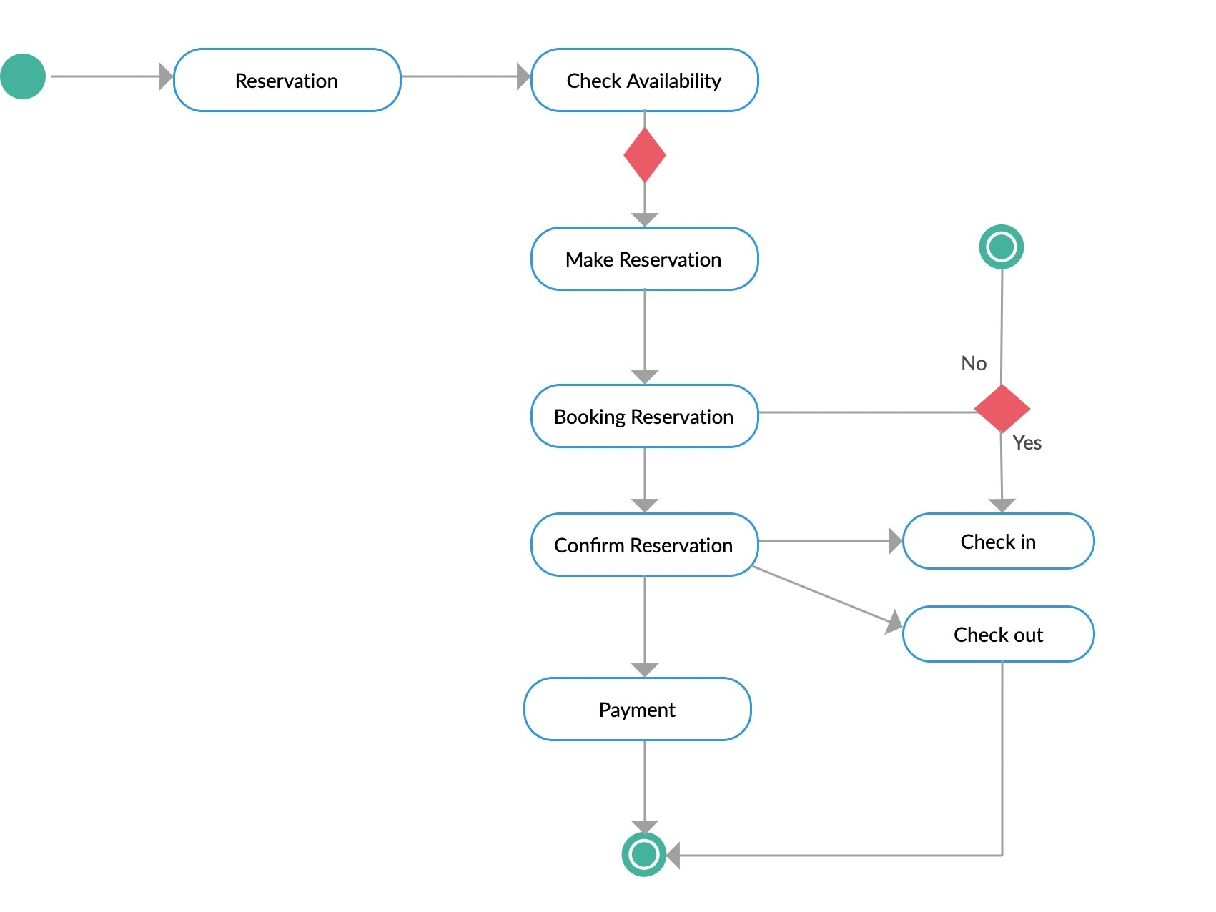
State Diagram

Slide 26
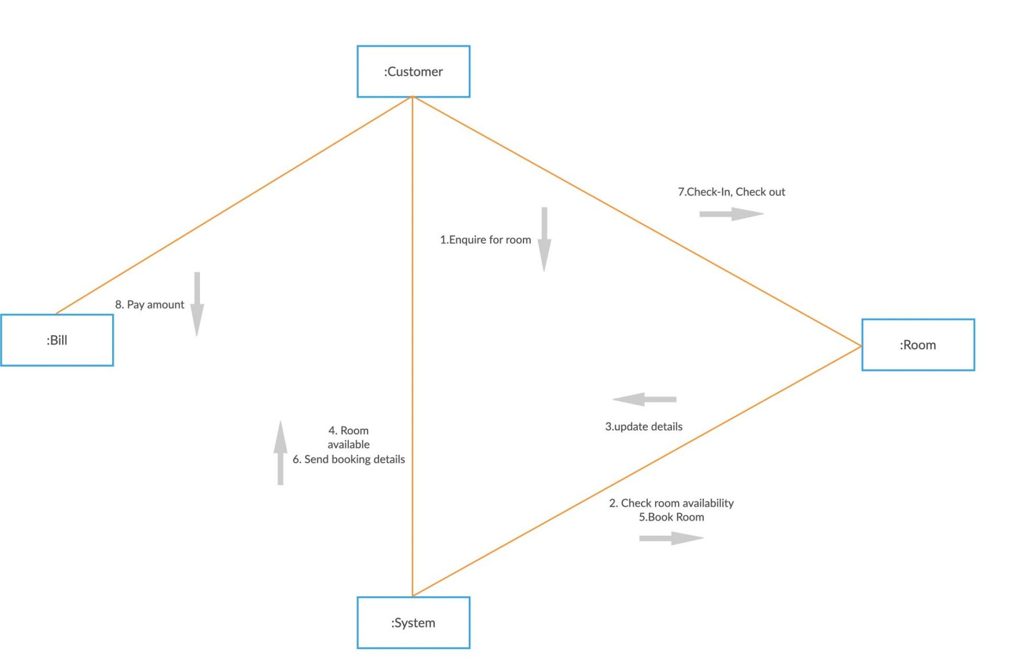
Collaboration diagram

Slide 27
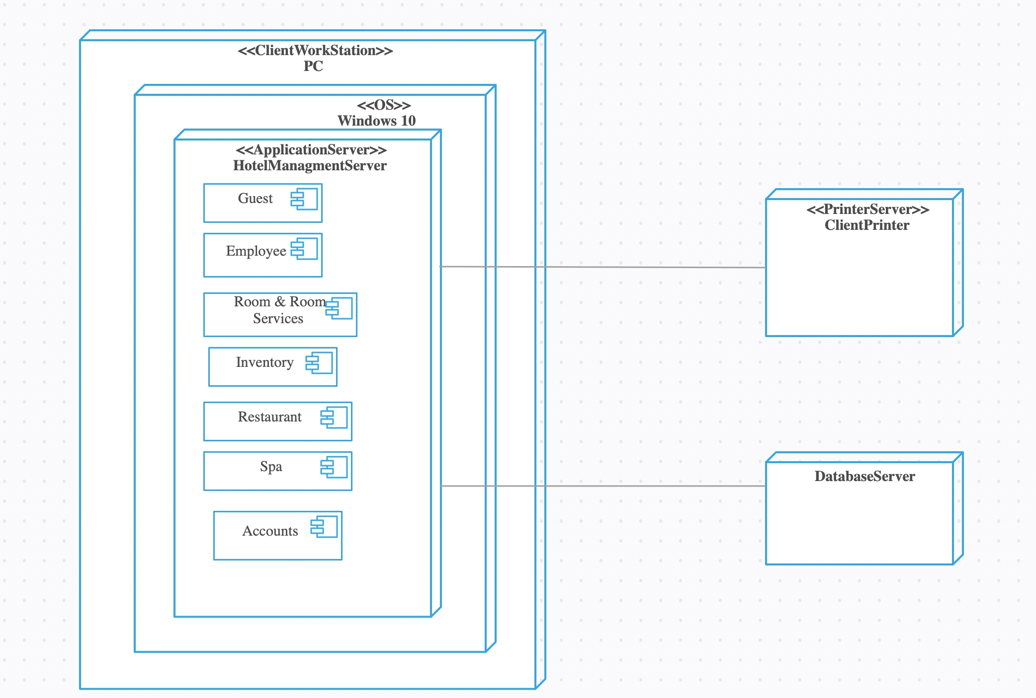
Deployment diagram

Slide 28
Front End Sample

Slide 29
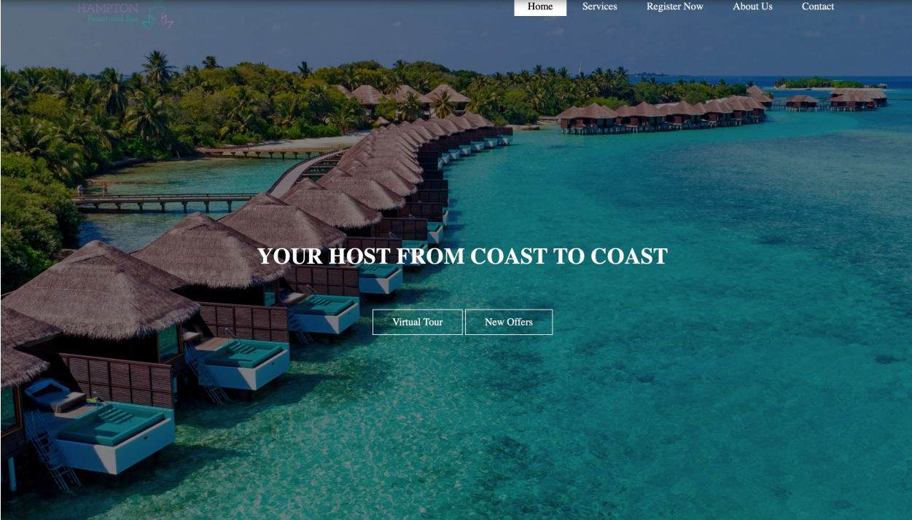

Slide 30
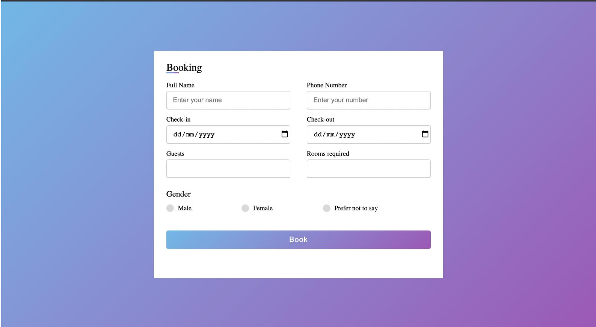

Slide 31
Module-1

Slide 32
. Module 1 code HTML - <!DOCTYPE html> <!DOCTYPE html> <html> <head><title>HILTON GROUP OF HOTELS</title> <link rel="stylesheet" type="text/css" href="css/style.css"> </head> <body><header> <div class="main"> <div class="logo"> <img src="Hampton.png"> </div>
<ul> <li class="active"><a href="#">Home</a></li> <li><a href="#">Services</a></li> <li><a href="#">Register Now</a></li> <li><a href="#">About Us</a></li> <li><a href="#">Contact</a></li> </ul> </div> <div class="title"> <h1>YOUR HOST FROM COAST TO COAST</h1> </div> <div class="button"> <a href="#" class="btn">Virtual Tour</a> <a href="#" class="btn">New Offers</a> </div> </header> </body> </html> CSS - *{ margin: 0; padding: 0; font-family: Century Gothic; }header{background-image:linear-gradient(rgba(0,0,0,0.5),rgba(0,0,0,0.5)), url(../maldives.jpg); height: 110vh; background-size: cover; background-position: center; }ul{ float: right; list-style-type: none; margin-top: 25px;
}ul li{ display: inline-block; }ul li a{text-decoration: none; color: #fff; padding: 5px 20px; border: 1px solid transparent; transition: 0.6s ease; }ul li a:hover{ background-color: #fff; color: #000; }ul li.active a{ background-color: #fff; color: #000; }.logo img{ float: left; width: 150px; height: auto; opacity: 1 }.main{max-width: 1200px; margin: auto; }.title{position: absolute;
top: 50%; left: 50%; transform: translate(-50%,-50%); }.title h1{ color: #fff; font-size: 35px; }.button{position: absolute; top: 62%; left: 50%; transform: translate(-50%,-50%); }.btn{ border: 1px solid #fff; padding: 10px 30px; color: #fff; text-decoration: none; transition: 0.6s ease; }.btn:hover{ background-color: #fff; color: #000; }
HTML -
<!DOCTYPE html>
<!DOCTYPE html>
<html>
<head>
<title>HILTON GROUP OF HOTELS</title>
<link rel="stylesheet" type="text/css" href="css/style.css">
</head>
<body>
<header>
<div class="main">
<div class="logo">
<img src="Hampton.png">
</div>
<ul>
<li class="active"><a href="#">Home</a></li>
<li><a href="#">Services</a></li>
<li><a href="#">Register Now</a></li>
<li><a href="#">About Us</a></li>
<li><a href="#">Contact</a></li>
</ul>
</div>
<div class="title">
<h1>YOUR HOST FROM COAST TO COAST</h1>
</div>
<div class="button">
<a href="#" class="btn">Virtual Tour</a>
<a href="#" class="btn">New Offers</a>
</div>
</header>
</body>
</html>

Slide 33
CSS -
*{
margin: 0;
padding: 0;
font-family: Century Gothic;
}
header{
background-image:linear-gradient(rgba(0,0,0,0.5),rgba(0,0,0,0.5)), url(../maldives.jpg);
height: 110vh; background-size: cover;
background-position: center;
}
ul{
float: right;
list-style-type: none; margin-top: 25px;
}
ul li{
}
display: inline-block;
ul li a{
text-decoration: none; color: #fff;
padding: 5px 20px;
border: 1px solid transparent; transition: 0.6s ease;
}
ul li a:hover{
background-color: #fff; color: #000;
}
.button{
position: absolute; top: 62%;
left: 50%;
transform: translate(-50%,-50%);
}
.

Slide 34
btn{
border: 1px solid #fff; padding: 10px 30px; color: #fff;
text-decoration: none; transition: 0.6s ease;
}
.btn:hover{
background-color: #fff; color: #000;
}
ul li.active a{
background-color: #fff; color: #000;
}
.logo img{
float: left; width: 150px; height: auto; opacity: 1
}
.main{
max-width: 1200px; margin: auto;
}
.title{
position: absolute;
top: 50%;
left: 50%;
transform: translate(-50%,-50%);
}
.title h1{
color: #fff;
font-size: 35px;
}

Slide 36
Module-2

Slide 37
Html
<!DOCTYPE html>
<!DOCTYPE html>
<html>
<head>
<title>HILTON GROUP OF HOTELS</title>
<link rel="stylesheet" type="text/css" href="css/style.css">
</head>
<body>
<header>
<div class="main">
<div class="logo">
<img src="Hampton.png">
</div>
<ul>
<li class="active"><a href="#">Home</a></li>
<li><a href="#">Services</a></li>
<li><a href="#">Register Now</a></li>
<li><a href="#">About Us</a></li>
<li><a href="#">Contact</a></li>
</ul>
</div>
<div class="title">
<h1>YOUR HOST FROM COAST TO COAST</h1>
</div>
<div class="button">
<a href="#" class="btn">Virtual Tour</a>
<a href="#" class="btn">New Offers</a>
</div>
</header>
</body>
</html>

Slide 38
CSS
*{
margin: 0;
padding: 0;
font-family: Century Gothic;
}
header{
background-image:linear-gradient(rgba(0,0,0,0.5),rgba(0,0,0,0.5)), url(../ maldives.jpg);
height: 110vh; background-size: cover;
background-position: center;
}
ul{
float: right; list-style-type:
none;margin-top:
25px;
}
ul li{
display: inline-block;
}
ul li a{
text-decoration: none;color: #fff; padding: 5px 20px; border: 1px solid
transparent;transition: 0.6s ease;
}
ul li a:hover{
background-color: #fff;color: #000;
}
ul li.active a{
background-color: #fff;color: #000;
}
.logo img{
float: left; width:
150px;height: auto; opacity
}
.main{
max-width:
1200px;margin:
auto;
}

Slide 39
title{
position: absolute;top:
50%;
left: 50%;
transform: translate(-50%,-50%);
}
.title h1{
color: #fff;
font-size: 35px;
}
.button{
position: absolute;top:
62%;
left: 50%;
transform: translate(-50%,-50%);
}
.btn{
border: 1px solid #fff;padding: 10px 30px; color: #fff; text-decoration: none;transition: 0.6s ease;
}
.btn:hover{
background-color: #fff;color: #000;
}

Slide 41
Module-3

Slide 42
HTML
<!DOCTYPE html>
<html>
<head>
<title>Contact US Page</title>
<link rel="stylesheet" type="text/css" href="css/app.css">
<link rel="stylesheet" href="https://cdnjs.cloudflare.com/ajax/libs/font-awesome/4.7.0/css/ font-awesome.min.css">
</head>
<body>
<section class="contact">
<div class="content">
<h2>Conatct Us</h2>
<p>Our guests are the heart of our hotels. Your feedback is important to us, please share with us any comments you may have about our website, your stay at any Hampton property.
</div>
</p>
<div class="container">
<div class="contactInfo">
<div class="box">
<div class="icon"><i class="fa fa-map-marker" aria-
hidden="true"></i>
</div>
<div class="text">
<h3>Address</h3>
<p>Lower Tank Bund Rd, <br>Bhagyalaxmi
Nagar,Kavadiguda,<br>Hyderabad,Telangana <br>500080</p>
</div>
hidden="true"></i>
</div>
</div>
<div class="box">
<div class="icon"><i class="fa fa-phone" aria-
<div class="text">
<h3>Phone</h3>
<p>040 6652 2222</p>
</div>
</div>
hidden="true"></i>
<div class="box">
<div class="icon"><i class="fa fa-envelope-o" aria-
</div>
<div class="text">
<h3>Email</h3>
<p>wrub7d8i0e@temporary.net</p>

Slide 43
</div>
<div class="contactForm">
<form>
<h2>Send Message</h2>
<div class="inputBox">
<input type="text" name="" required="">
<span>Full Name</span>
</div>
<div class="inputBox">
<input type="text" name="" required="">
</div>
<span>Email</span>
<div class="inputBox">
<textarea required=""></textarea>
<span>Type your Message...</span>
</div>
<div class="inputBox">
<input type="submit" name="" value="Send">
</div>
</section>
</body>
</html>

Slide 44
CSS
@import url('https://fonts.googleapis.com/css2?family=Poppins&display=swap');
* {
margin: 0;
padding: 0;
box-sizing: border-box;
font-family: 'Poppins', sans-serif;
}
.contact {
position: relative; max-height: 100vh;
padding: 50px 100px; display: flex;
justify-content: center; align-items: center; flex-direction: column; background:
}
body {
}
background: linear-gradient(135deg, #71b7e6, #9b59b6);
.contact .content {
max-width: 800px; text-align: center;
}
.contact .content h2 {
font-size: 36px; font-weight: 500; color: black;
}
.contact .content p {
font-weight: 300; color: #ﬀf;
margin-top: 30px;
}
.container {
width: 100%; display: flex;
justify-content: center; align-items: center; margin-top: 30px;
}
.container .contactInfo {
width: 50%; display: flex;
flex-direction: column;
}
.container .contactInfo .box { position: relative; padding: 20px 0; display: flex;
}

Slide 45
container .contactInfo .box .icon { min-width: 60px;
height: 60px; background: #ﬀf; display: flex;
justify-content: center; align-items: center; border-radius: 50%; font-size: 22px;
}
.container .contactInfo .box .text { display: flex;
margin-left: 20px; font-size: 16px; color: #ﬀf;
flex-direction: column; font-weight: 300;
}
.container .contactInfo .box .text h3 { font-weight: 500;
color: black;
}
.contactForm {
width: 40%; padding: 40px; background: #ﬀf;
}
.contactForm h2 {
font-size: 30px; color: #333;
font-weight: 500;
}
.contactForm .inputBox { position: relative; width: 100%; margin-top: 10px;
}
.contactForm .inputBox input,
.contactForm .inputBox textarea { width: 100%;
padding: 5px 0; font-size: 16px; margin: 10px 0; border: none;
border-bottom: 2px solid #333; outline: none;
resize: none;
}
contactForm .inputBox span { position: absolute;
left: 0;
padding: 5px 0; font-size: 16px; margin: 10px 0;
pointer-events: none; transition: 0.5s; color: #666;
}
.contactForm .inputBox input:focus ~ span,
.contactForm .inputBox input:valid ~ span,
.contactForm .inputBox input:focus ~ span,
.contactForm .inputBox textarea:valid ~ span
{
color: #e91e63; font-size: 12px;
transform: translateY(-20px);
}
.contactForm .inputBox input[type="submit"] { width: 100px;
background: #00bcd4; color: #ﬀf;
border: none; cursor: pointer; padding: 10px; font-size: 18px;
}
@media (max-width: 991px) {
.contact {
padding: 50px;
}
.container {
flex-direction: column;
}
}

Slide 46
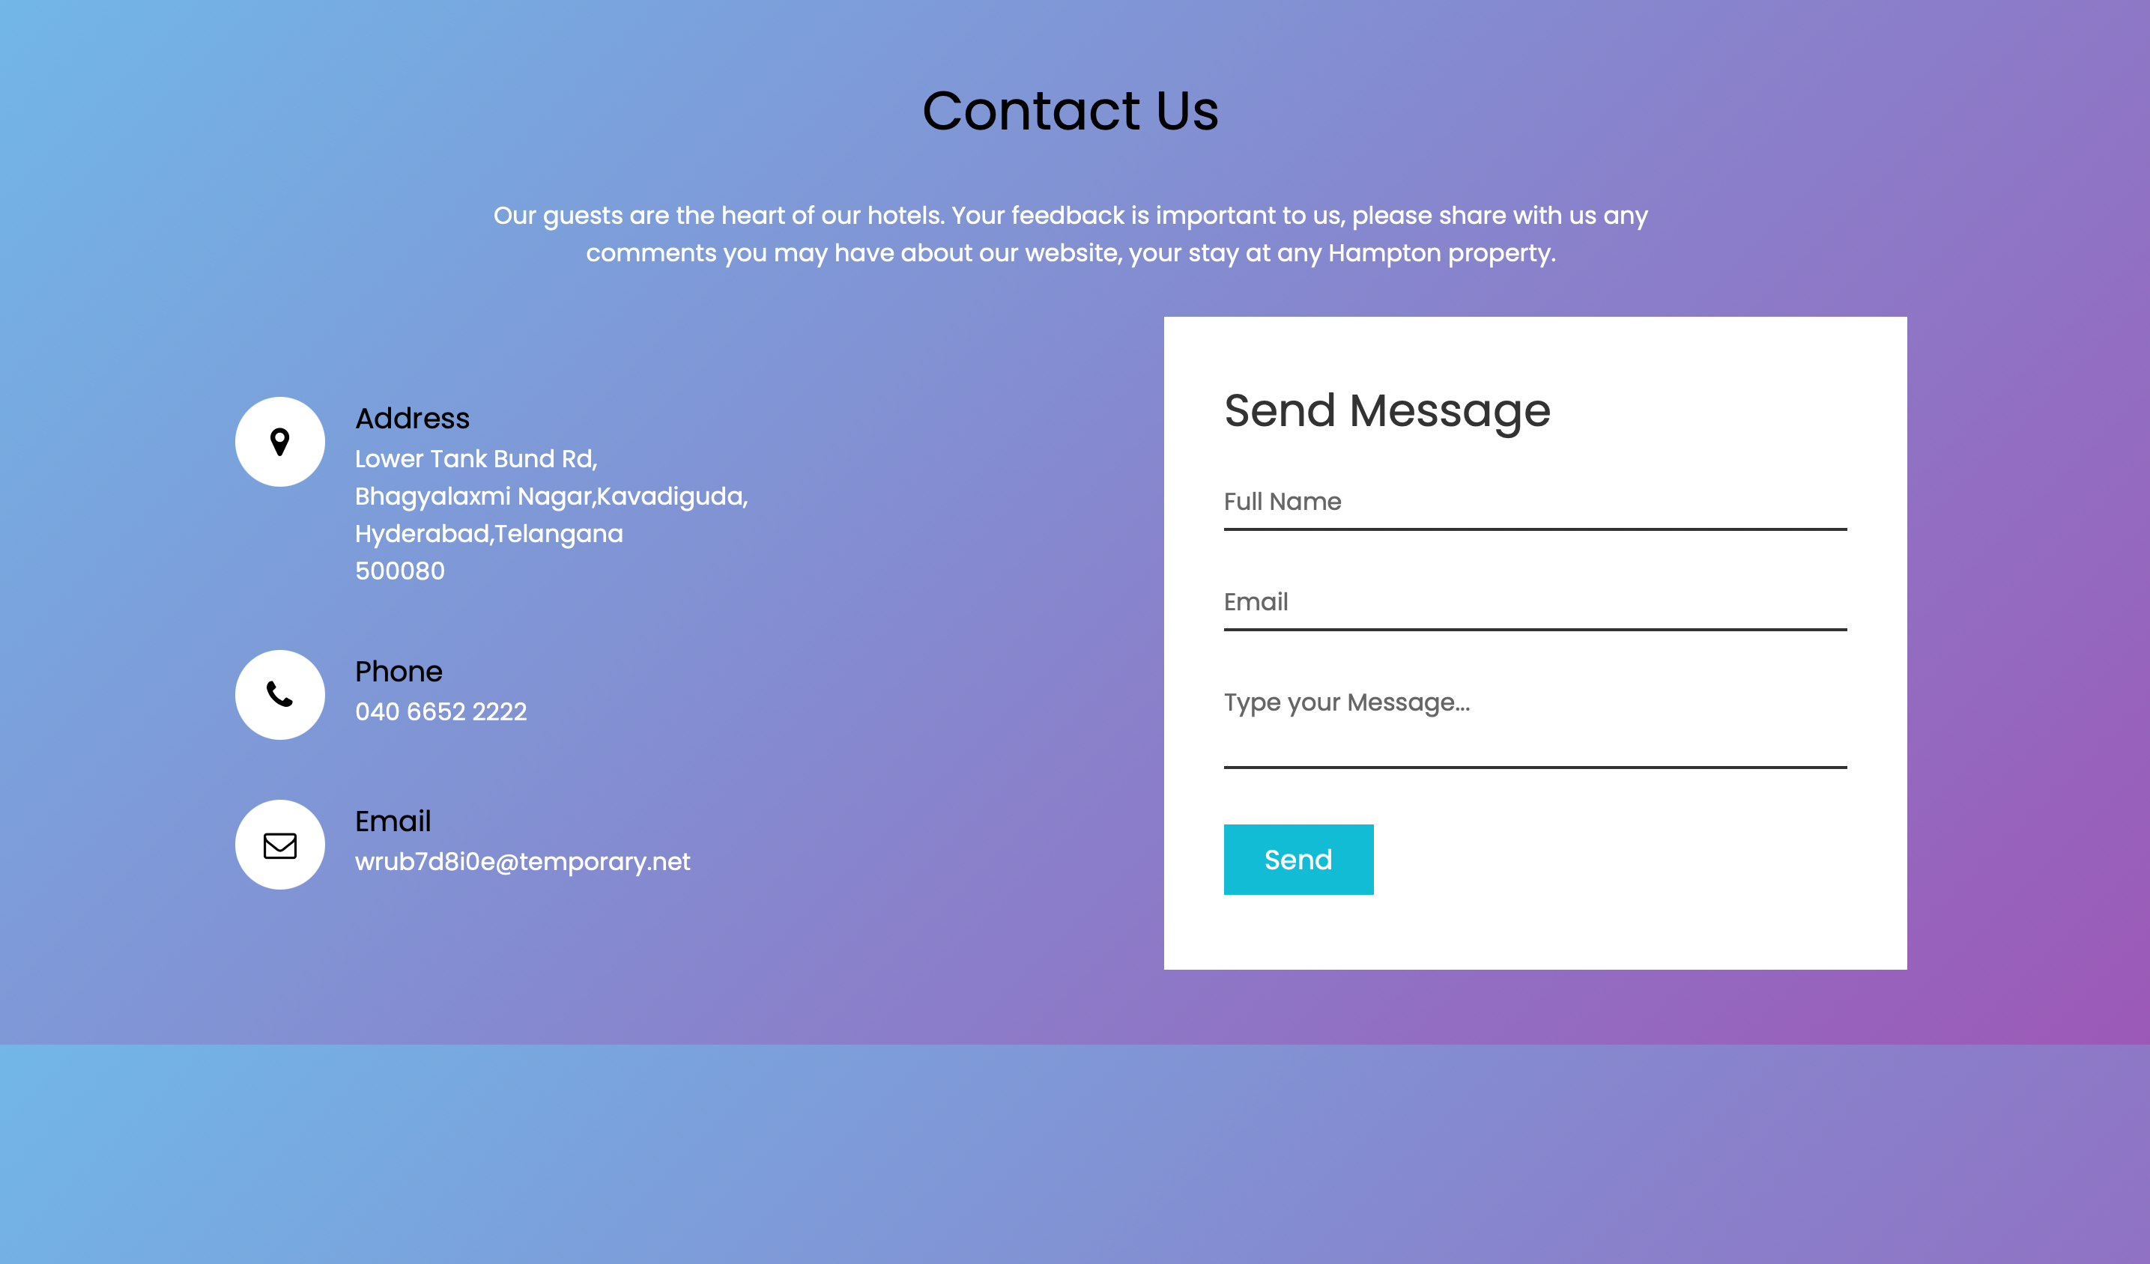

Slide 47
Test Plans

Slide 48
Test Report
Function | Description | % Test case executed | % Test case passed | Remarks
New User | Check new user is created | 100 | 100 | Test case executed andpassed.
Login User | Check user is able to login | 100 | 100 | Test case executed and passed.
Preference formworking | Check preference form isworking | 100 | 100 | Test case executed and passed.
Recommend rooms displayed | Check all types of rooms are displayed in the website | 100 | 100 | Test case executed andpassed.
Extra facilities displayed | Check user can book the extra features | 100 | 100 | Test case executedand passed.
Rooms Avaliable | Check number of rooms available to be booked | 100 | 100 | Test case executed andpassed.

Slide 49
Types of Testing, Methodology, Tools
Category | Methodology | Tools Required
Functional Requirements | White box testing | Developer
Non-Functional Requirements | White box testing | Developer

Slide 50
Functional Test Cases
Test ID (#) | Test Scenario | Test Case | Execution Steps | Expected Outcome | Actual Outcome | Status | Remarks
1 | Launchwebsite | Websiteshould belaunchedat givenlink | 1. Open localhost:5000in web browser | Index pageshould bedisplayed | Indexpage is displayed | Pass | Success
2 | User Registrat ion | Accept valid details | User clicks on Register Now Enter the all the details | Raise alert if Phone Number field is empty | Alert is raised | Pass | Success
3 | VerifyNewUserRegistrat ion | Acceptvalidpassword | 1. User clicks onRegister Now2. Enter the all the details3. Click the ‘BOOK’ | Raise alert ifrooms required ornumber of guests field isempty. | Alert israised | Pass | Success

Slide 51
Non-Functional Test Cases
Tes t ID (#) | Test Scenario | Test Case | ExecutionSteps | Expected Outcome | Actual Outcome | Status | Remarks
1 | Provideaccurateinfo aboutrooms and other facilities | Recommen ded roomsshouldbe spot on | 1. Open the website2. Get accuraterecommendations | The rooms and facilitiesshould be top class | Top class facilities | Pass | Success
2 | User-friendlyinterface | Interfaceshould beeasilyuseable andinteractive | 1. Open website2. Have a lookall the bookingoptions provided | All navigationlinks should beclearly definedand accessible | Easy to useinterface | Pass | Success
3 | Secureandconfiden tial system | Recommen dations andpreferencesshould beaccessibleonly byregisteredusers | 1. Register user2. Access toall the details | Visible only tologged in users | Appears after login | Pass | Success

Slide 52
Thank You
Done By-
Rishabh Mishra RA1911027010097
Ritesh Chandwani RA1911027010094
Pavan Kiran RA1911027010084
Ankur Choudhary RA1911027010089

